Slide 1
ConvNetJS
Deep Learning in the Browser
Christoph Körner
Slides available on bit.ly/1WicamQ

Slide 2

About me
Visual Computing at Vienna University of Technology
Intern in the Big Data Team at T-Mobile Austria
Author of Data Visualizations with D3 and AngularJS
Author of Learning Responsive Data Visualization
Contributor at n3-line-chart
Organizer of Vienna Kaggle Meetup
LinkedIn: at.linkedin.com/in/christophkoerner
Twitter: @ChrisiKrnr
Google+: +ChrisiHififm
Github: github.com/chaosmail

Slide 3
Agenda
Deep Learning
ConvNetJS
Caffe models in ConvNetJS
Whats next

Slide 4
Deep Learning (in 5 min)

Slide 5
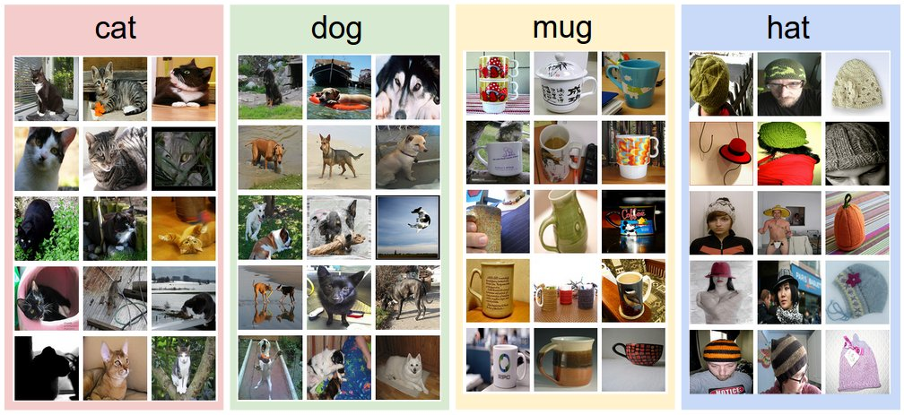
Image Classification
Source: CS231n Github

Slide 6

Spatial Localization and Detection
Source: CS231n Lecture Notes

Slide 7
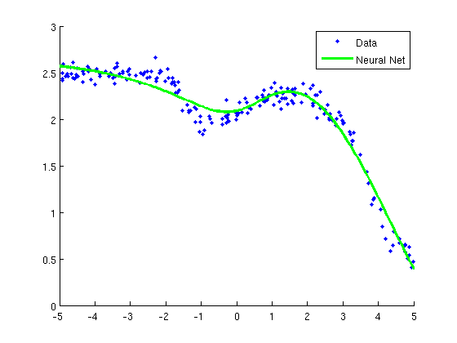
General: Regression
Source: CS UBC

Slide 8
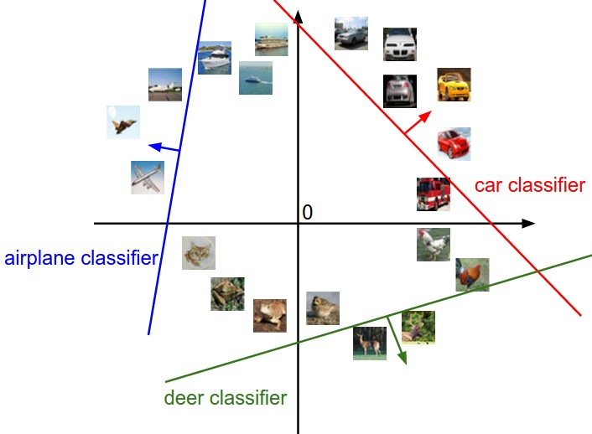
Example
Source: CS231n Github

Slide 9
Neural Nets: Ingredients
Linear Classification
Non-linearities (Activation functions)
Compute Error Loss
Optimization (Back-propagation)

Slide 10
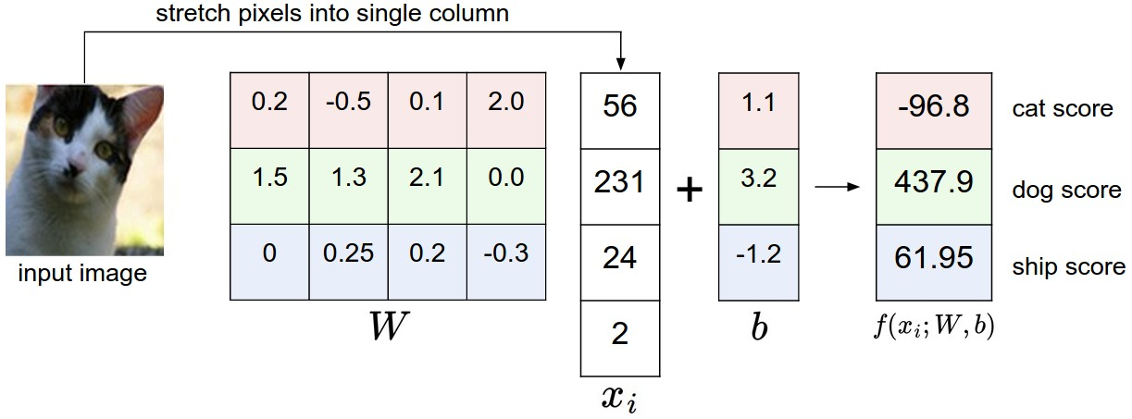
Linear Classifier y = Wx + b
Source: CS231n Github

Slide 11
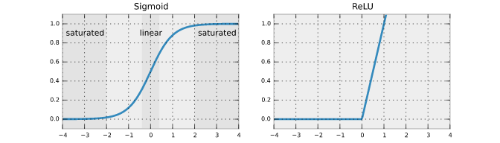
Non-linearities (Activation functions)
Needed for building universal approximators
Source: deepdish.io

Slide 12
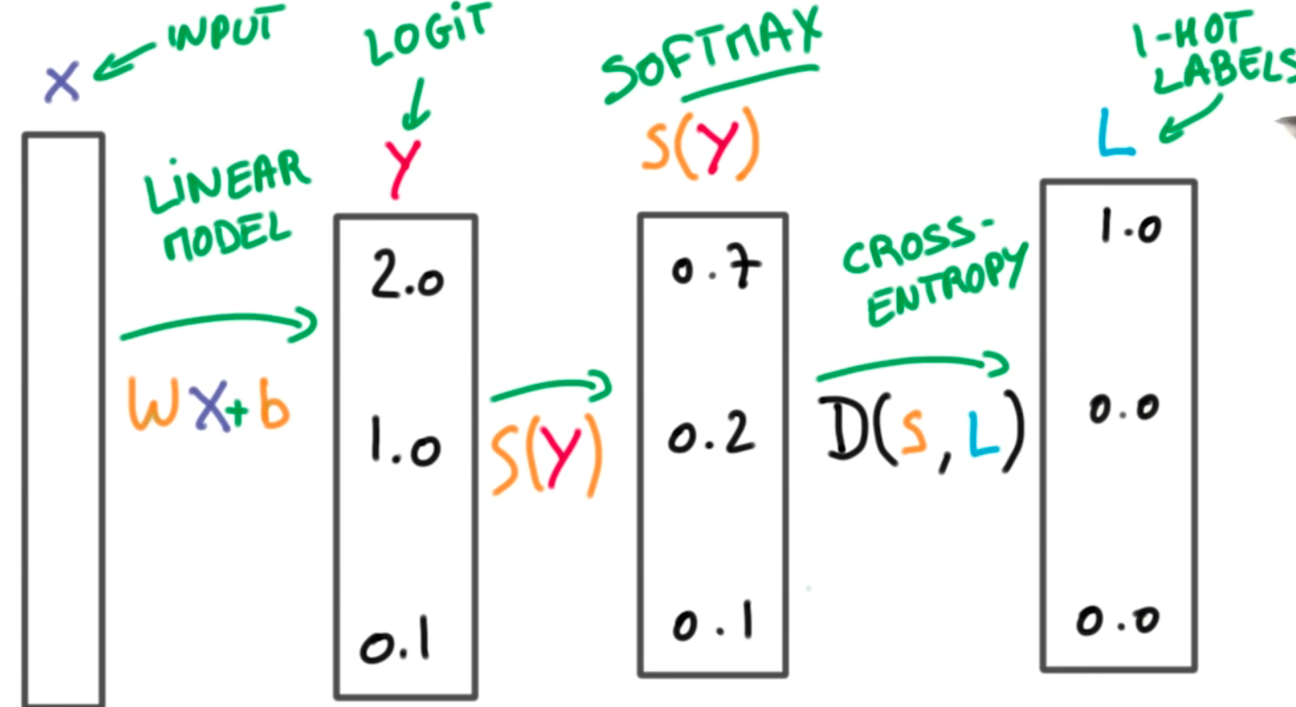
Compute the Error (Loss)
Source: Udacity Tensorflow, Interactive Demo

Slide 13
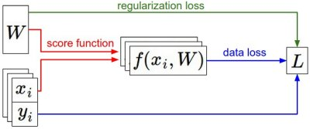
Optimization (1)
Source: CS231n Github

Slide 14
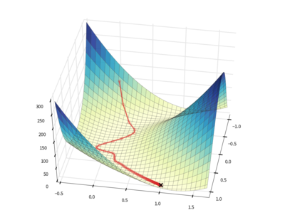
Optimization (2)
Source: lmjohns3.com

Slide 15

Neural Network
Source: CS231n Github

Slide 16
Deep Neural Nets: Ingredients
Convolution of Volumes
Pooling
Many layers, many parameters, much fun

Slide 17
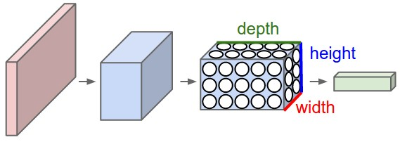
Convolutions
Source: CS231n Github

Slide 18


Pooling
Source: CS231n Github

Slide 19
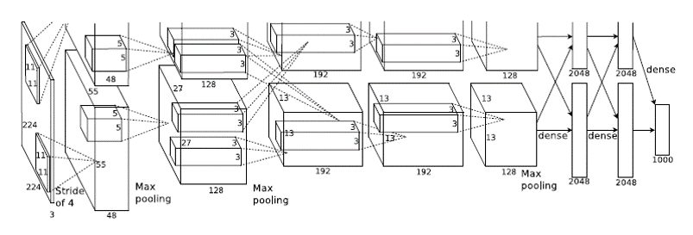
Many Layers, AlexNet
Source: ImageNet Classification with Deep Convolutional Neural Networks

Slide 20

And more Layers, GoogLeNet
Source: Going deeper with convolutions, Great Slides

Slide 21
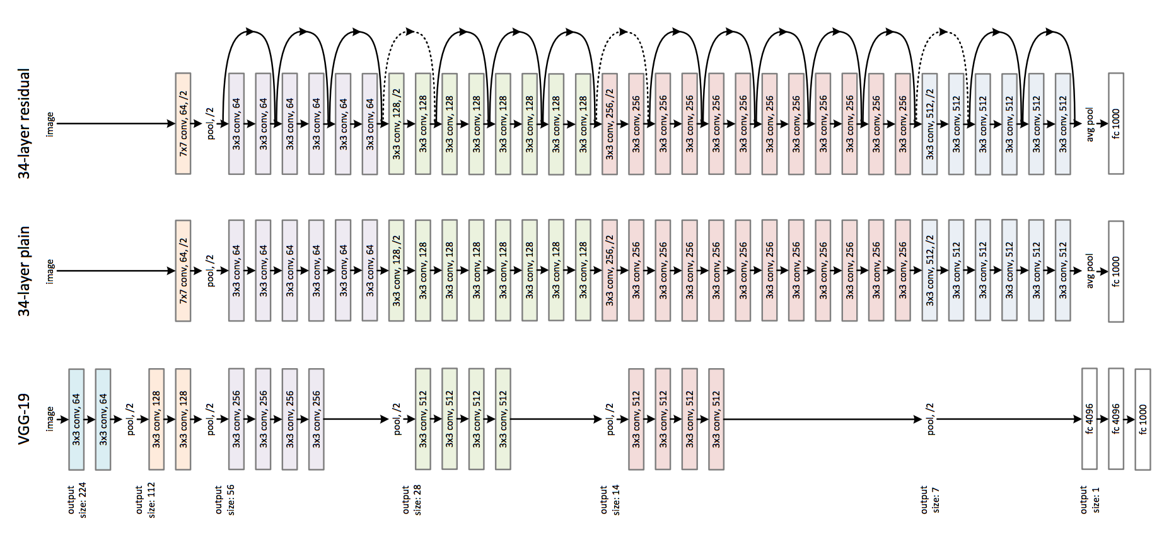
And More Layers, VGG vs. ResNet
Source: Deep Residual Learning for Image Recognition

Slide 22
ConvNetJS
Source: Github by Andrej Karpathy

Slide 23
Convolutional Neural Nets in the Browser
Network and Layers
including Conv, Pool, etc.
Network Training
Including SGD, momentum, etc.
Visualization of Activations
JSON import and export
Cool demos: MNIST Train, CIFAR Train, CIFAR
Source: ConvNetJS

Slide 24
ConvNetJS Layers
Input
Inner Product:
FC, Conv
Pool (only max pool)
Dropout
Normalization:
LRN
Loss:
Softmax, Regression, SVM
Non-linearities:
ReLU, Sigmoid, Maxout, Tanh,

Slide 25
ConvNetJS Training
Optimization methods:
SGD
Adam
Adadelta
Adagrad
Nestrov momentum

Slide 26
convnetjs.Net
Layers stored as Arrays
Net.layers
Forward and Backward pass
Net.forward(vol)
Net.backward(y)
Import & Export
Net.toJSON
Net.fromJSON

Slide 27
convnetjs.Layer
Layer dimensions
Layer.out_sx
Layer.out_sy
Layer.out_depth
Forward and Backward pass
Layer.forward(vol)
Layer.backward(y)
Stores last volumes
Layer.in_act
Layer.out_act

Slide 28
convnetjs.Vol
Volumes stored as Typed Arrays (column vectors)
Vol.get(x, y, d)
Vol.set(x, y, d, value)
Dimensions
Vol.sx
Vol.sy
Vol.depth
Weights and Gradients
Vol.w
Vol.dw

Slide 29
Typed Arrays
Float32Array, Float64Array, …
Typed arrays are fast for storing large blobs
 | Array | Float64Array | Float32Array
Create zero filled | 0.624 | 0.266 | 0.139
Fill iter. / method | 0.228 | 0.228 / 0.817 | 0.270 / 0.954
Copy array | 5.425 | 0.050 | 0.024

Slide 30
Fast for loops
for (var i = 0, len = A.length; i < len; ++i) { // Code goes here }
Source: Stackoverflow

Slide 31
Problems of ConvNetJS
Slow, due to sequential computation
Array layer structure (no Inception modules)
No Recurrent Networks
Dropout
Limited memory in the browser, JSON
I don’t want to train models in the browser

Slide 32
Using pre-trained Models
Offline training (many GPUs, long time)
Export weights
Perform only forward pass (no BP needed)

Slide 33
Finding pre-trained Models
Popular pre-trained models are available
Caffe
Model-Zoo
FCN Berkley Vision
Structure in ProtoBuf files *.prototxt
Weights in binary files *.caffemodel

Slide 34
CaffeJS - Caffe Models in the Browser
Work in progress…
Parses *.prototxt files to ConvNetJS models
Transforms *.caffemodel weights into text files (one file per layer) - #1669 in Keras
Updates weights in ConvNetJS models
Graph structure for layers + layerIterator

Slide 35
Why CaffeJS
Teaching & Learning
No requirements (but a browser)
Understand & analyze Deep Nets
Debugging of Deep Nets (FF and BP)
Visualize the filters, layers, activations, etc.
Feed webcam stream into Deep Nets

Slide 36
Problems of CaffeJS
Forward pass still slow
6s for GoogLeNet
Most time spend in early convolutions
Too much overhead for weights (fc6 and fc7)
Uses only layers, no blobs ()
Memory issues (above 200MB) - can we convert weights into images?

Slide 37
Whats next
Network in a Network (NIN)
Fully Convolutional Nets (FCN)
WebCL: Heterogeneous parallel computing
WebAssembly: Compilation to the web
Deep Compression: AlexNet on 7MB
More Layers!

Slide 38
Some more useful resources
Tensorflow Playground: Neural Nets
CS231n: Lecture, Github, and videos
CS231n: Caffe Tutorial
Udacity Tensorflow
DeepDream

Slide 39
Thank you.

